Slide 1
Real-Time Sketch-Based Adaptive DDoS Detection for ISP Network 2021 Security & Communication Networks no citations
Rohullah Jahanafrooz
1401/09/20

Slide 2
Limitations
Methods:
Machine Learning model updating are time consuming
Where to deploy?
Efficient: Backbone-base traffic aggregation and detection

Slide 3
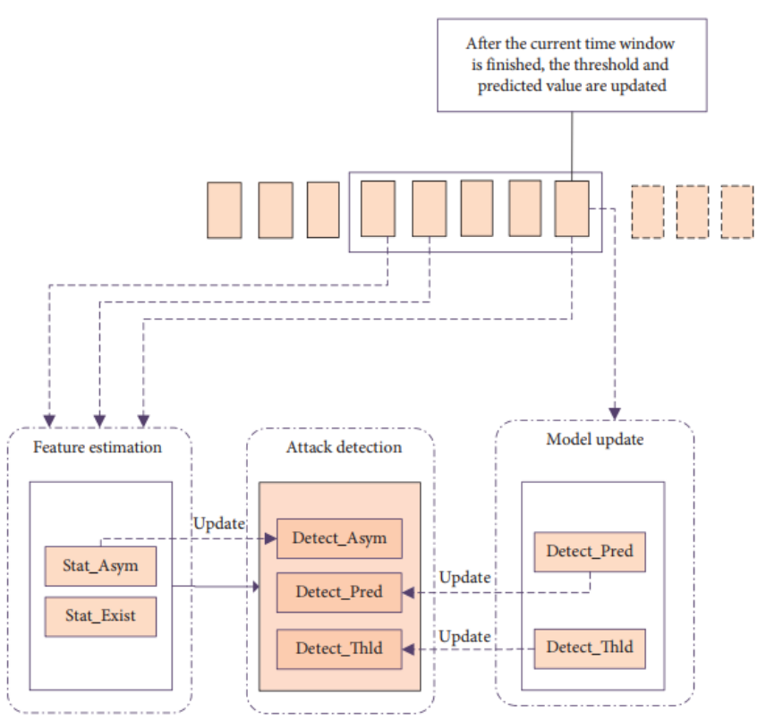
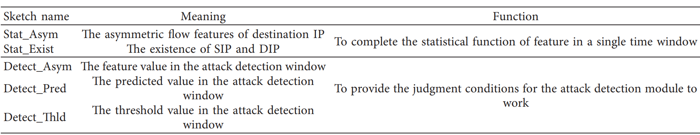
Architecture
Four sketch tables:

Slide 4
Detection
Key idea: significant change in asymmetric value for a victim ip’s single feature (DIP).
Flow(srcIP,dstIP) aggregation in each time window
Detection: threshold on a feature, that has asymmetric value for destIP(DIP).
Feature of DIP: current window value, predicated value, threshold calculated based on previous time windows.
At the end of window Updates only normal IP’s predictive and threshold values ( so the all three tables in Attack detection module are constantly updating)
➔ DIP is victim IP

Slide 5
Flowchart
Arriving flow record
Sketch_exist(sip,dip)++
Sip Dip
Sketch_exist(dip,sip)++

